Slide 1



Producer:蒋子韬，李和平

Slide 2
CONTENTS
Chapter4
Chapter3
Etiquette
Chapter2
Art
Chapter1
Classification
Origin
Life is like tea! Tea has two postures: sinking and floating. Tea drinkers have two gestures: pick up and put down; Being calm when sinking and unattached when floating.

Slide 3
The orgin
of tea culture

Slide 4
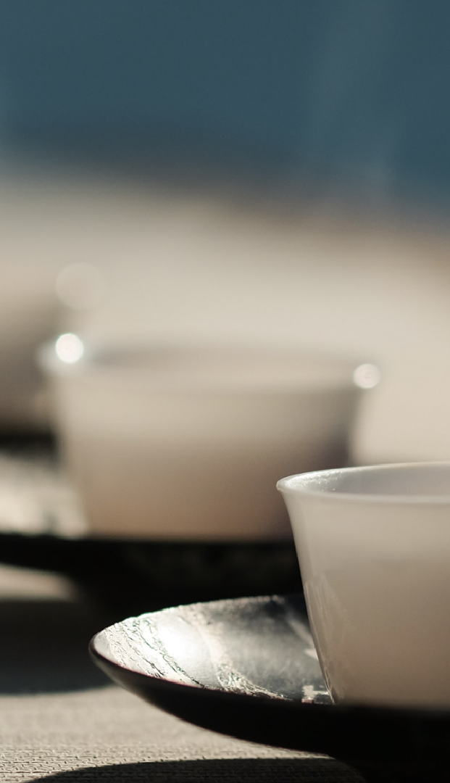
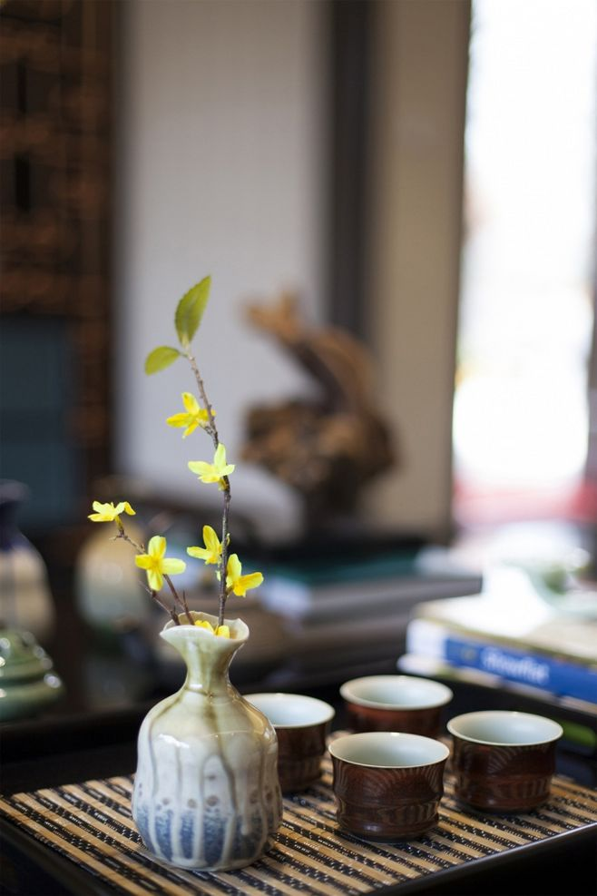
According to legend, the discovery of tea can be traced back to 2737 BC, when a Chinese emperor discovered some tea leaves that had fallen into his hot water pot. After drinking it, he felt refreshed and invigorated, and tea began to become popular.
In China, tea gradually evolved into a culture and ritual, especially during the Tang and Song dynasties. During these periods, tea was used as a part of socializing and entertainment, and was also regarded as a medicine and a cosmetic.
Tea culture spread to other countries over time, such as Japan, Korea, and Vietnam. In these countries, tea is also regarded as an important cultural symbol, and there are many unique tea cultural traditions.

Slide 5
The classfication
of tea culture

Slide 6

Classified by Processing Techniques
Green tea: Green tea refers to tea made from fresh and tender tea leaves that have been processed through steps such as killing the green, rolling, and drying, resulting in a tea with a fresh and delicate taste. There are many varieties of green tea, such as Longjing, Biluochun, and Maofeng.
Black tea:Black tea is tea that has been processed through steps such as rolling and fermentation, resulting in a tea with a strong taste and a reddish-brown color.The varieties of black tea include Qimen black tea,Dianhong and others.
Oolong tea: Oolong tea is a type of tea that falls between green tea and black tea, and has undergone several steps such as rolling and semi-fermentation, resulting in a tea with complex fragrances such as floral and fruity. There are many varieties of oolong tea, such as Tie Guan Yinand Wuyi rock tea.

Slide 7
Classified by Processing Techniques
Brick tea:Brick tea is a type of tea that has been pressed into brick or cake shapes, and has undergone several steps similar to Pu-erh tea, such as fermentation, killing the green, and drying, resulting in a tea with a strong and aged fragrance, suitable for long-term storage. There are many varieties of brick tea, such as Pu-erh brick tea and Fuzhuan.
Flower tea:Flower tea is a type of tea made by mixing flowers such as jasmine and roses with tea leaves such as green tea, resulting in a tea with a fresh floral fragrance and light tea aroma, favored by many women. There are many varieties of flower tea, such as jasmine tea and rose tea.

Slide 8
The art
of tea culture
Etiquette

Slide 9
Tea Art
Tea art, also known as tea ceremony or chado, is a traditional Chinese practice that emphasizes th e preparation and presentation of tea. In tea art, the host carefully prepares and serves tea to guests following specific procedures. They use high-quality green tea called matcha.
Tea art is not just about drinking tea, but also about creating a peaceful and harmonious atmosphere. The host selects aesthetically pleasing tea utensils and decorates the tea room with seasonal flowers and natural elements.
Tea art is steeped in tradition and symbolism, and each movement and gesture has meaning. It is seen as a way to cultivate mindfulness, respect, and social harmony.
茶清如露
心洁如佛

Slide 10
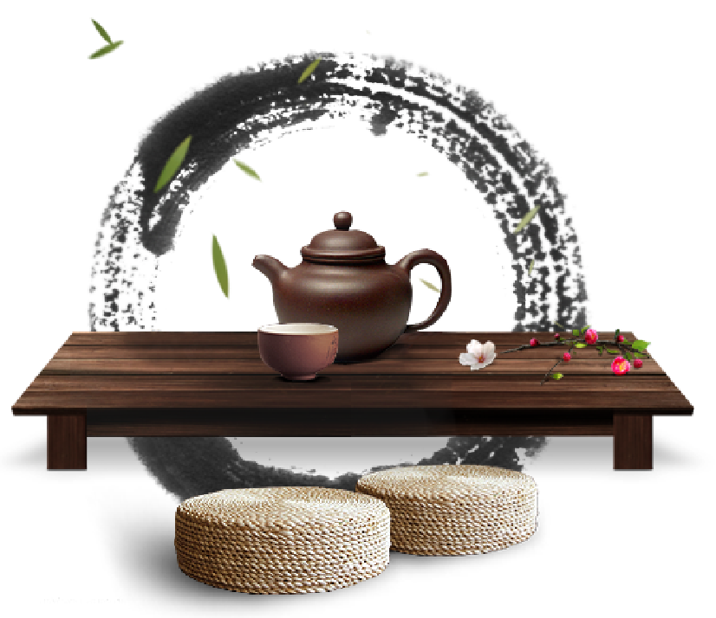
Tea Zen
Tea Zen is a practice that combines the art of tea with the principles of Zen Buddhism. It emphasizes being mindful and appreciating the present moment while preparing and drinking tea. The tea is prepared and served with focused attention and intention, and the atmosphere is calming and simple.Tea Zen helps to cultivate inner stillness and clarity of mind through the practice of meditation. It is a way to bring peace and harmony into daily life.
茶清如露
心洁如佛

Slide 11
The etiquette
of tea culture

Slide 12
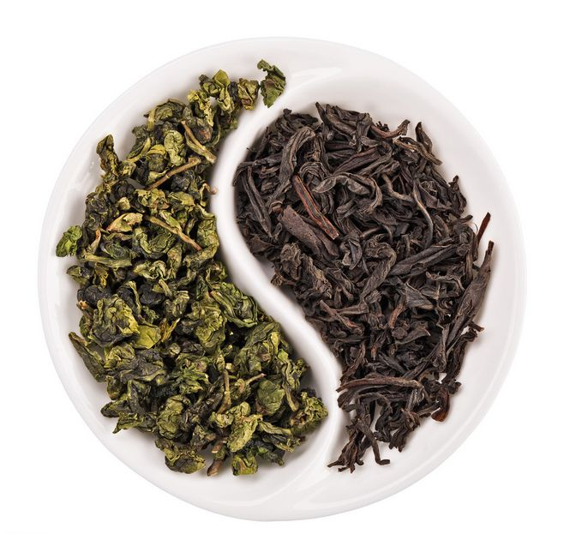
1.Properly greet and thank the host -When attending a tea ceremony, greet the host politely and thank them for inviting you. Showing gratitude and respect is important.
4.Wait to be served - Do not pour your own tea. Wait for the host or most senior person to serve you. Then express your thanks.
2.Remove your shoes - In traditional Chinese tea culture, guests remove their shoes when entering the host's home as a sign of respect
5.Take slow, small sips - Taste the tea slowly and in small sips. Slurping the tea is considered rude.
3.Receive the teacup with both hands - Gently receive the teacup from the server with two hands to show respect and gratitude.

Slide 13
Thank you for appreciating
lecturer:蒋子韬

